Slide 1
Section 13.3
Geometric Sequences;
Geometric Series
Copyright © 2012 Pearson Education, Inc. Publishing as Prentice Hall.

Slide 2
Copyright © 2012 Pearson Education, Inc. Publishing as Prentice Hall.

Slide 3
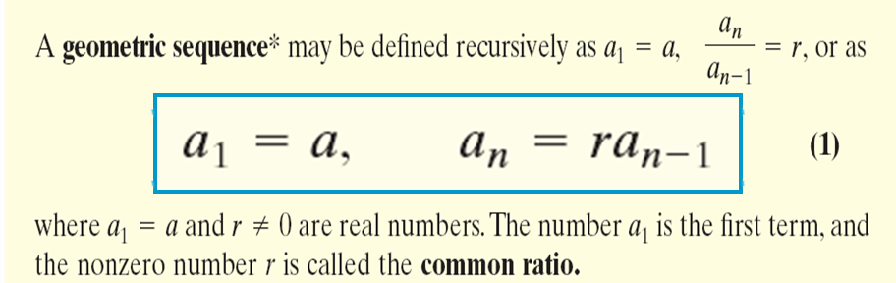
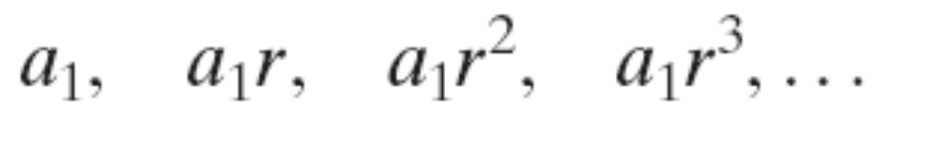
Geometric Sequence
Copyright © 2012 Pearson Education, Inc. Publishing as Prentice Hall.

Slide 4

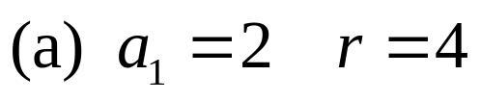
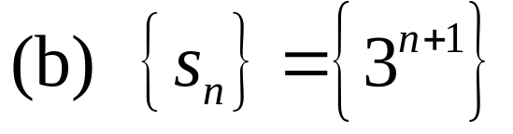
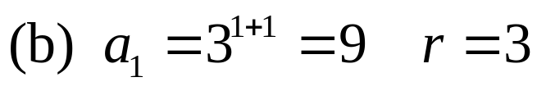
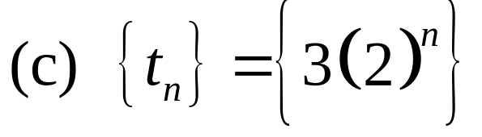
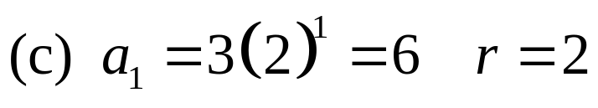
Show that the sequence is geometric. List the first term and the common ratio.
(a) 2, 8, 32, 128, . . .
Copyright © 2012 Pearson Education, Inc. Publishing as Prentice Hall.

Slide 5
Copyright © 2012 Pearson Education, Inc. Publishing as Prentice Hall.

Slide 6
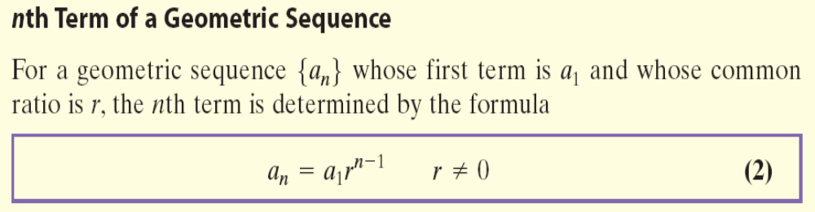
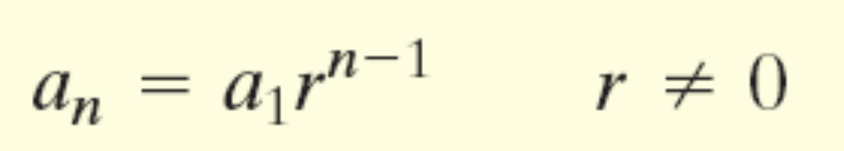
Copyright © 2012 Pearson Education, Inc. Publishing as Prentice Hall.

Slide 7
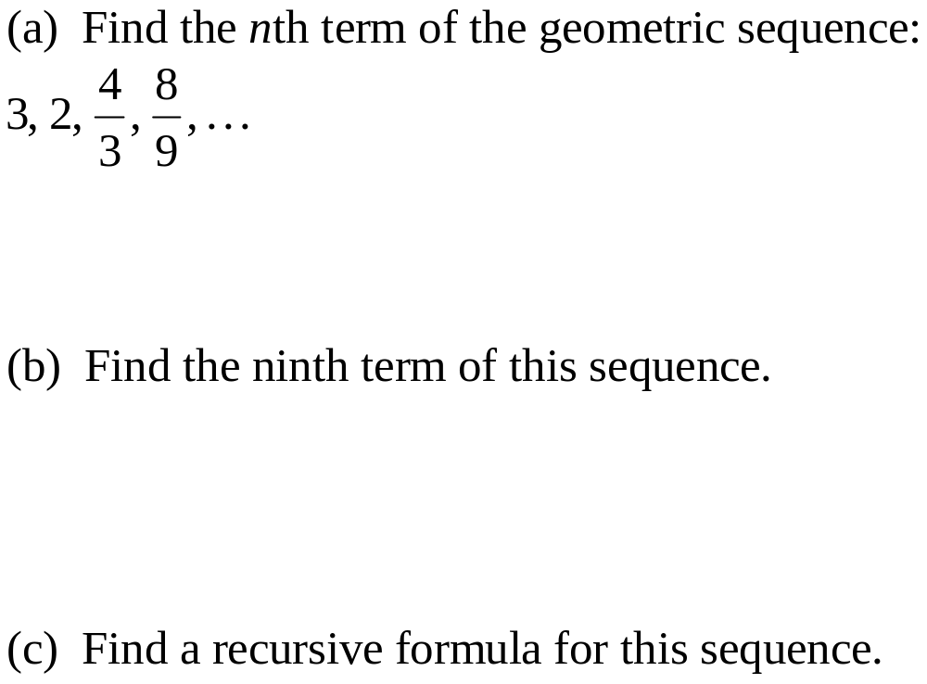
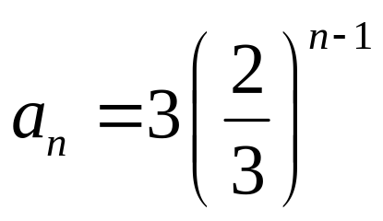
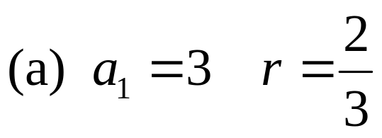
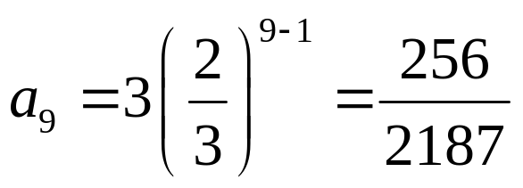
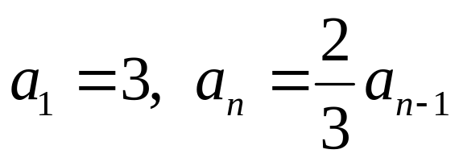
Copyright © 2012 Pearson Education, Inc. Publishing as Prentice Hall.

Slide 8
Copyright © 2012 Pearson Education, Inc. Publishing as Prentice Hall.

Slide 9
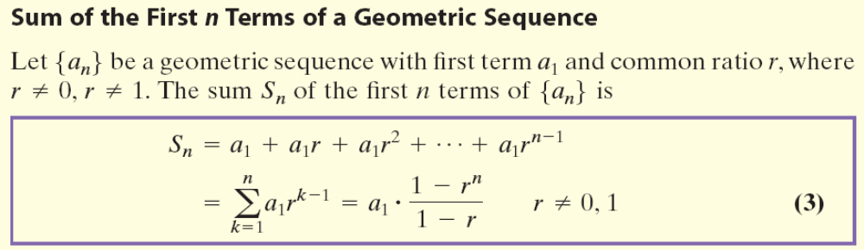
Copyright © 2012 Pearson Education, Inc. Publishing as Prentice Hall.

Slide 10
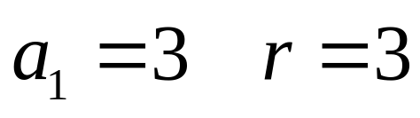
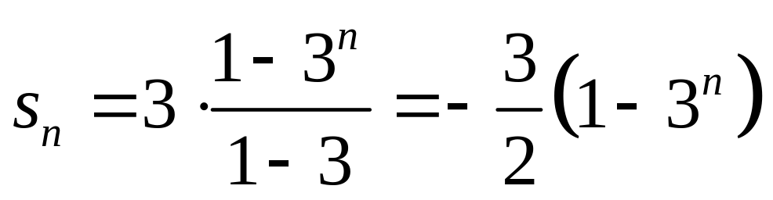
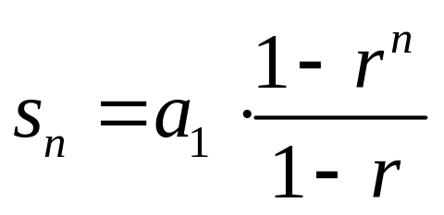
Copyright © 2012 Pearson Education, Inc. Publishing as Prentice Hall.

Slide 11

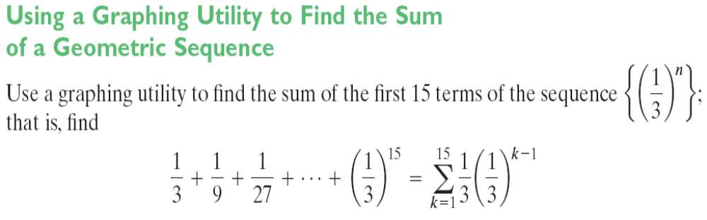
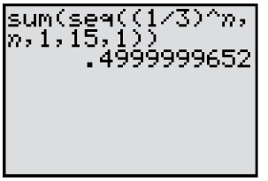
Copyright © 2012 Pearson Education, Inc. Publishing as Prentice Hall.

Slide 12

Copyright © 2012 Pearson Education, Inc. Publishing as Prentice Hall.

Slide 13

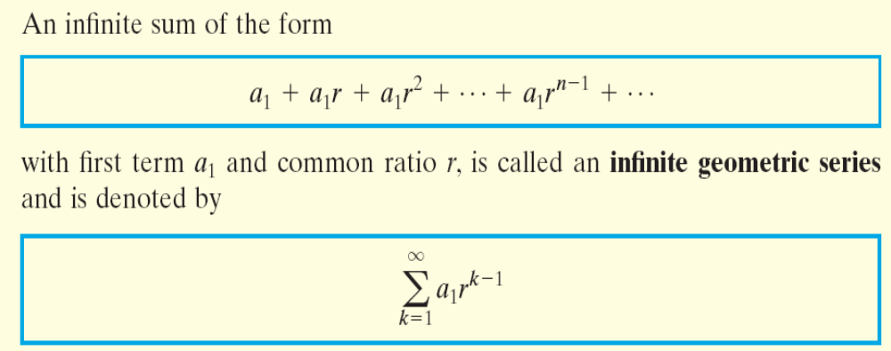
Copyright © 2012 Pearson Education, Inc. Publishing as Prentice Hall.

Slide 14
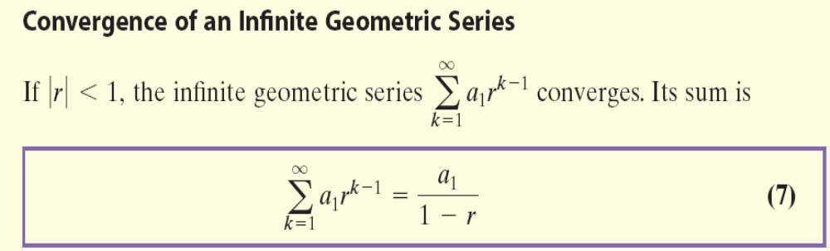
Copyright © 2012 Pearson Education, Inc. Publishing as Prentice Hall.

Slide 15

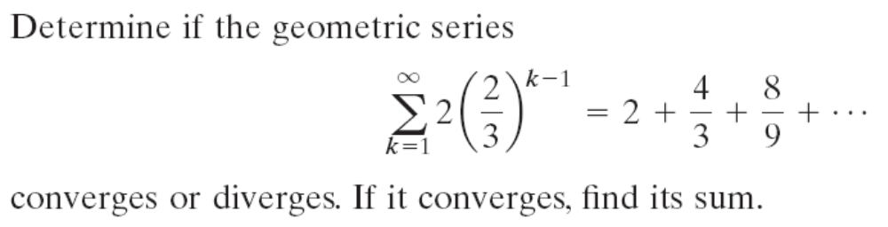
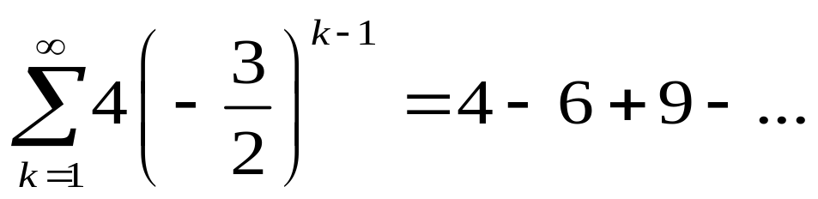
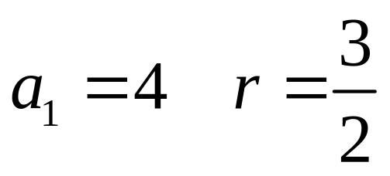
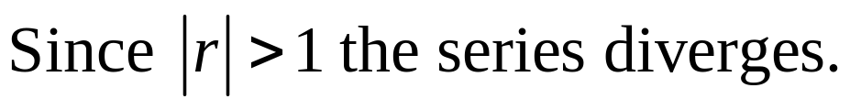

Copyright © 2012 Pearson Education, Inc. Publishing as Prentice Hall.

Slide 16


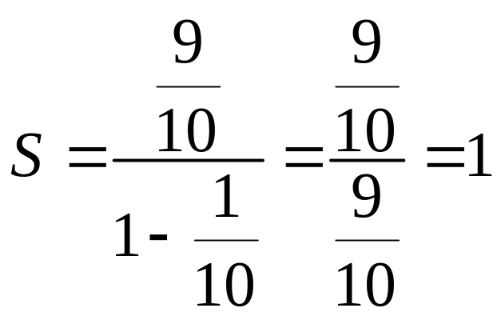
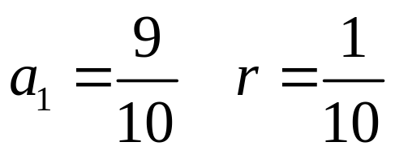
Copyright © 2012 Pearson Education, Inc. Publishing as Prentice Hall.

Slide 17

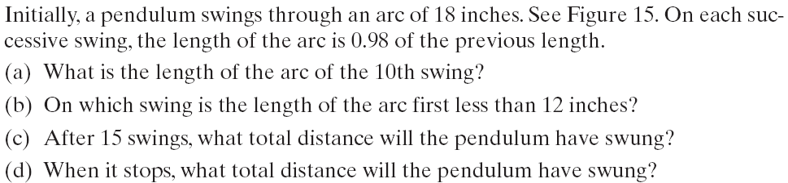
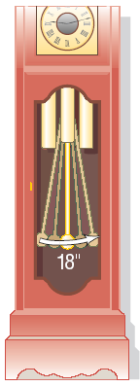
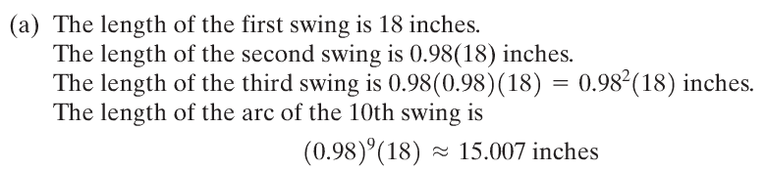
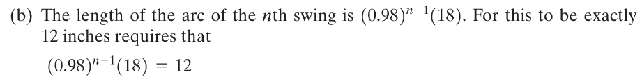

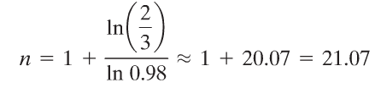

Copyright © 2012 Pearson Education, Inc. Publishing as Prentice Hall.

Slide 18
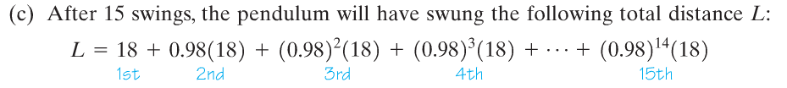
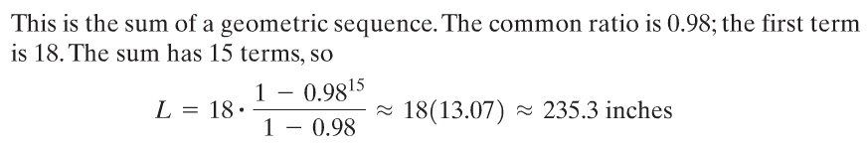
Copyright © 2012 Pearson Education, Inc. Publishing as Prentice Hall.

Slide 19
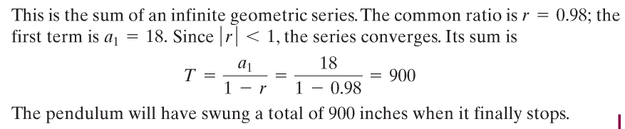
Copyright © 2012 Pearson Education, Inc. Publishing as Prentice Hall.

Slide 20

Copyright © 2012 Pearson Education, Inc. Publishing as Prentice Hall.

Slide 21
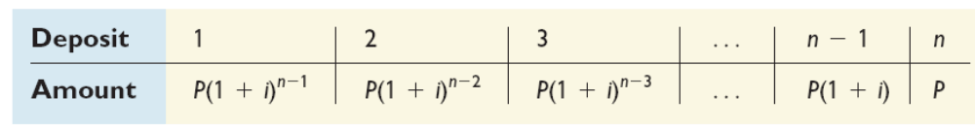
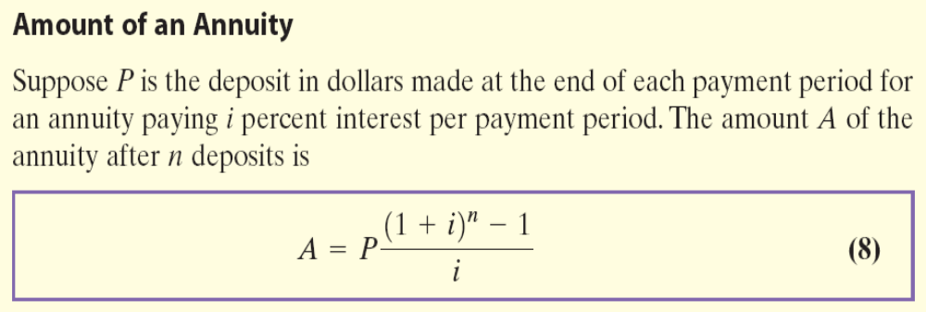
Copyright © 2012 Pearson Education, Inc. Publishing as Prentice Hall.

Slide 22
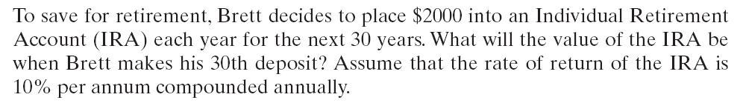
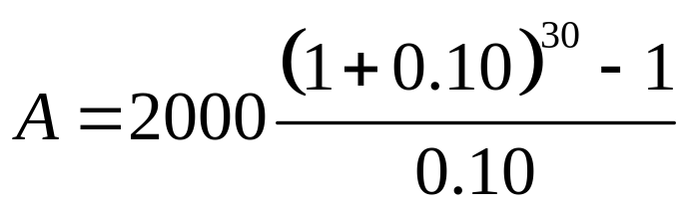
Copyright © 2012 Pearson Education, Inc. Publishing as Prentice Hall.

Slide 23
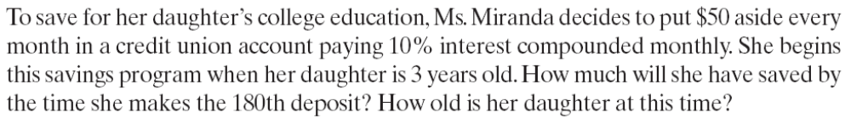
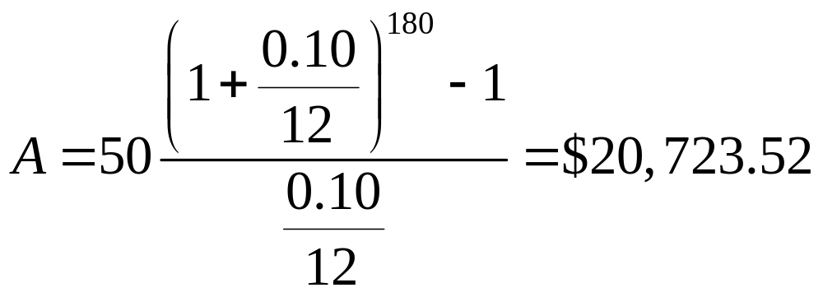
Copyright © 2012 Pearson Education, Inc. Publishing as Prentice Hall.

